Slide 1
Hide page.
Notes for the teachers not for the students.
Teachers are cordially requested to follow the instruction below ‘click to add notes’ options.
Notes:
Instruction for the teachers.

Slide 2
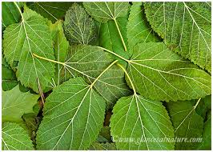
May Allah bless you all my dear students.
Notes:
Welcome slide.

Slide 3
Introduction
Teacher’s Introduction | Introduction of Class & Subject
Md Hasan Hafizur Rahman Senior Lecturer & Head of the Department (English) Cambrian School & College Campus-5 Dhaka | Class-VIII Subject-English 1st Paper
Notes:
Introduction.

Slide 4
Let us watch and observe some images.
Notes:
Teacher may advance the students to the topic.

Slide 5
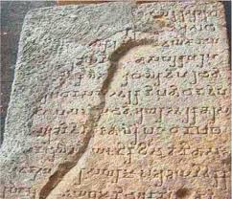
Writing on stone
Notes:
Teacher may ask a single student to say something about this picture. After that he may show the box.

Slide 6
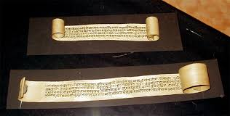
Writing on bark.
Notes:
Teacher may ask another student to say something about this picture. After that he may show the box.

Slide 7
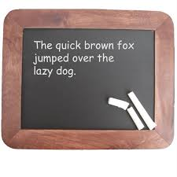
Writing on slate.
Notes:
Teacher may ask another student to say something about this picture. After that he may show the box.

Slide 8
Now we write on papers.
Notes:
Teacher may ask another student to say something about this picture. After that he may show the box.

Slide 9
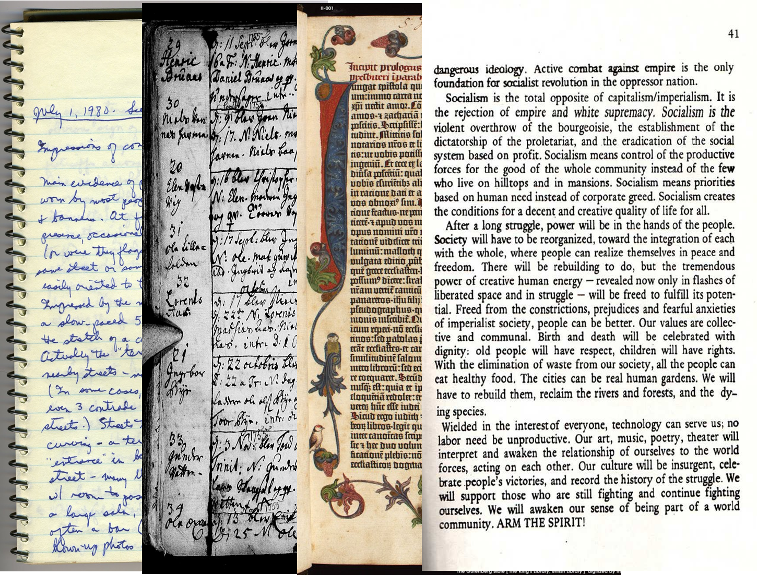
Written records.
Notes:
Teacher may ask another student to say something about this picture. After that he may show the box.

Slide 10
What have you observed by the images?
A gradual development of writing materials and at last it has been fixed into papers.
Has it advanced our life?
If yes, let us see our today’s lesson.
Notes:
Teacher may ask the students about the first box. He may let them some times to say something. Then he may advance forward.

Slide 11
Our Today’s Lesson is-
Paper has advanced our life.
Unit-9, Lesson-6
Notes:
Lesson declaration.

Slide 12
Learning outcomes
At the end of the lesson, we will be able to-
ask and answer questions
read aloud texts with proper sounds, stress and intonation
write answers to the questions
write short paragraphs
Notes:
This lesson will cover all the four skills speaking, listening, reading and writing.

Slide 13
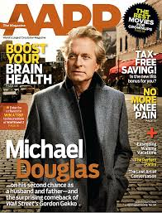
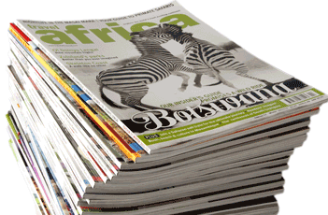
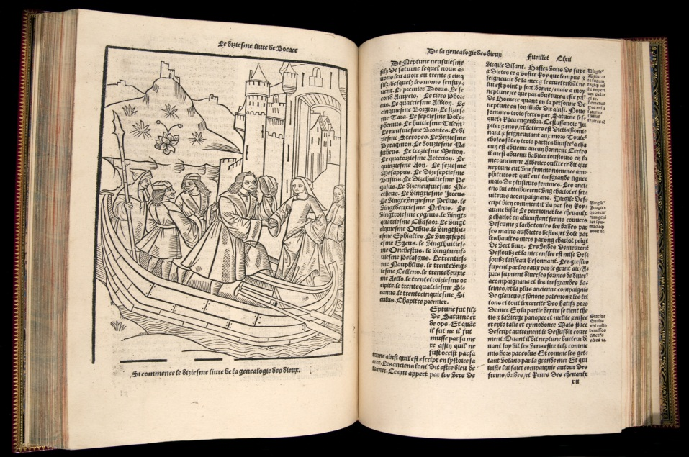
A Look at the picture and say what this is. Discuss with you partner.
Notes:
Teacher may ask the students to say something about the pictures. He may give them some times to answer of section A. If he wants, her can go to the page No 21 directly by clicking the right arrow to skip key word option,

Slide 14
Key words of the lesson
Notes:
Teacher can skip key words option if he can find the lesson difficult to complete in the class. But if the students ask about the key words, then teacher may show this option.

Slide 15
Record
Meaning : Evidence/documentation
Give me the record of your information.
Notes:
Teacher may show the word ‘record’ first. Then he ask the students to tell the meaning of the word. If they are able, ok. Then teacher can show them the meaning and sentence making at last.

Slide 16
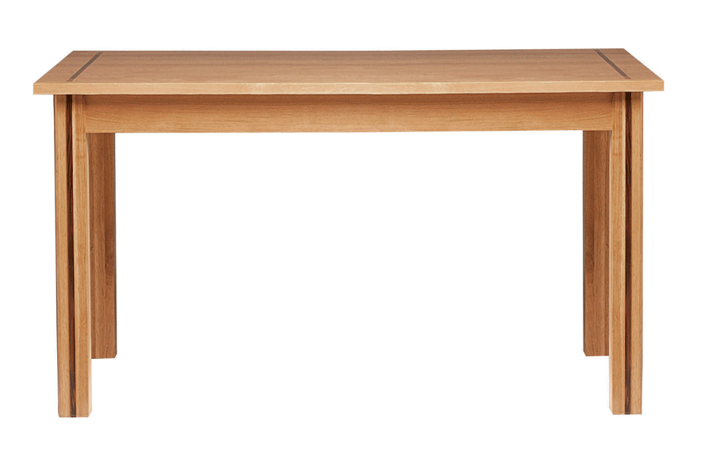
surface
Over
Outward/
upper portion
Meaning
Under
Surface water of the river is not clean.
Notes:
Teacher may show the word ‘surface’ first. Then he ask the students to tell the meaning of the word. If they are able, ok. Then teacher can show them the meaning and sentence making at last.

Slide 17
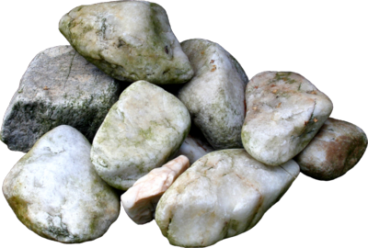
Stone
Rock/pebbles
Notes:
Same as above.

Slide 18
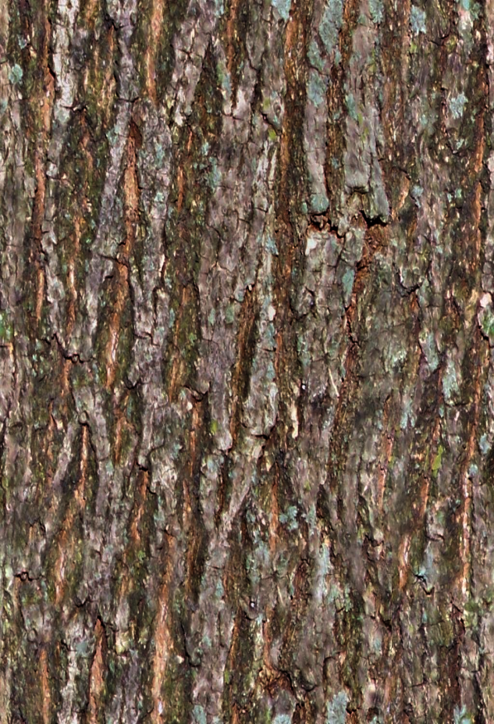
Bark
Skin of the tree
Surface of the tree
In Bengali it is called bakol.
There is no tree without bark.
Notes:
Same as above slides.

Slide 19
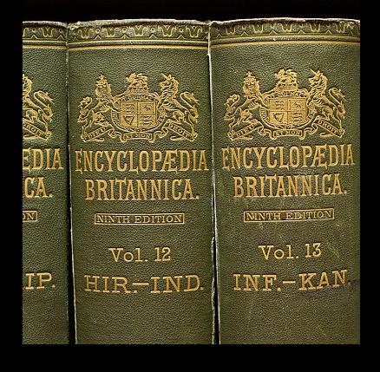
Encyclopedia
Written records of the world.
Notes:
Same as above slides.

Slide 20
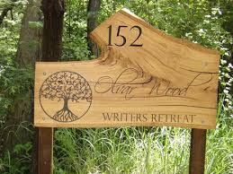
Wood Plunk
People wrote on wood plunk in ancient time.
Notes:
Teacher may advance according to animation.

Slide 21
Digital
To the point/
Real/Actual/perfect
29
Notes:
Teacher may advance according to animation.

Slide 22
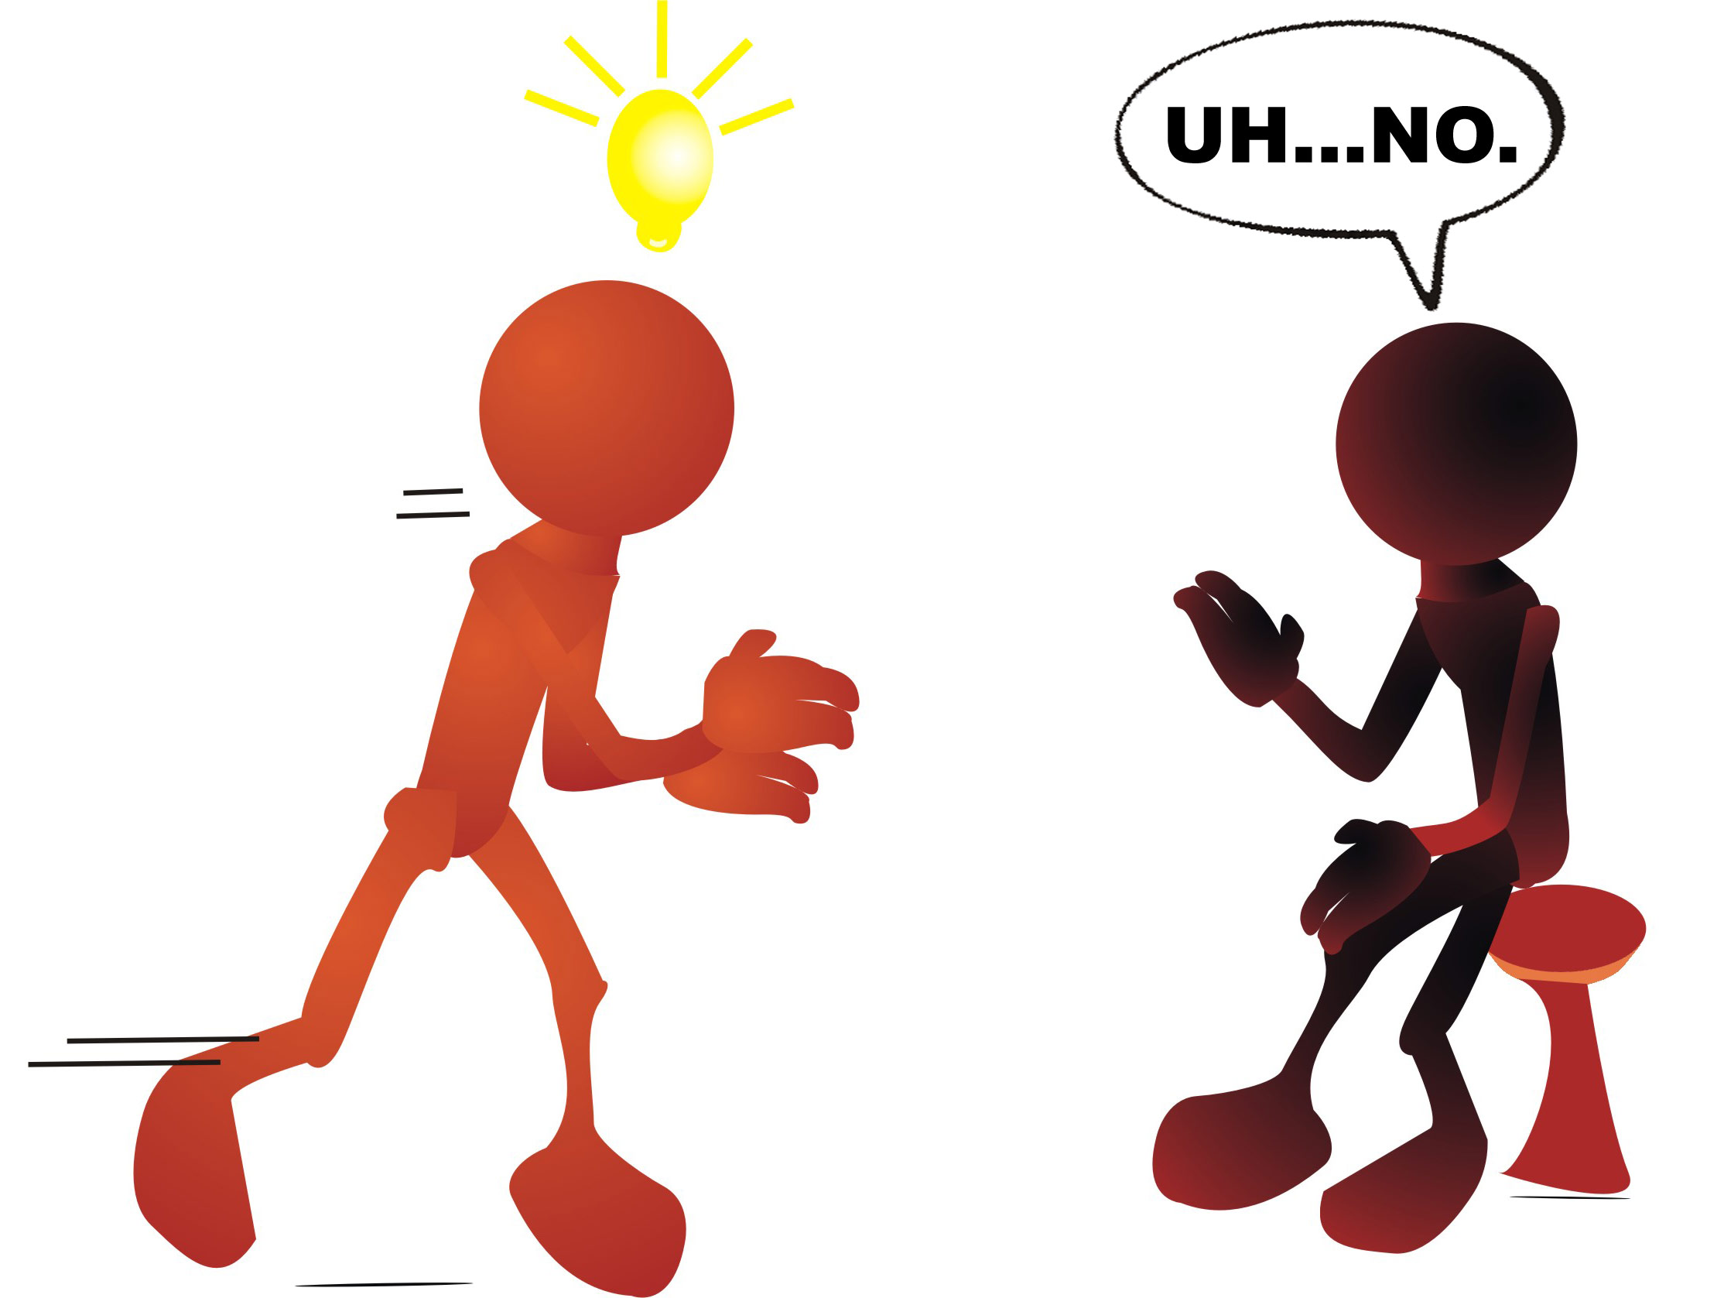
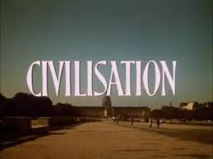
Communication of ideas is at the centre of --------------.
Notes:
Teacher may advance according to animation.

Slide 23
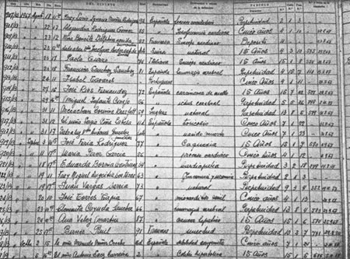
But what does it need?
Written records.
Notes:
Same as above slides.

Slide 24
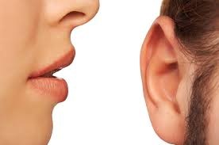
How did people transfer ideas in ancient time?
speaking
listening
Then?
Notes:
Main topics begun. Teacher may ask the question first, Then he can show the pictures and afterward he can advance.

Slide 25
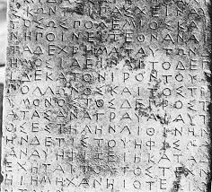
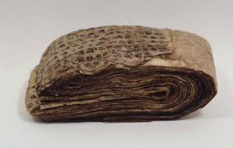
Writing.
Was it very easy?
No, because writing material was not available.
What did people write then on?
People wrote then on-
stone
metal
wood
bark
Notes:
Teacher should give the students some seconds to think for answering the questions. Then he can advance forward accordingly.

Slide 26
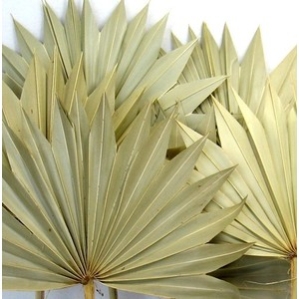
and
leaves.
Notes:
Same as above.

Slide 27
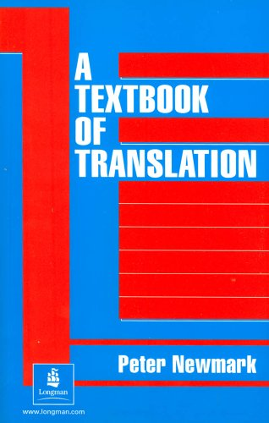
Knowledge was very restricted before paper age.
It is very easy to carry a
book of 100 page.
But is it at all easy to carry a book of 100 pieces of stones?
Notes:
Teacher should go according to animation.

Slide 28
For this problem, people looked for easy writing materials for ages. Finally, paper was invented in China in 105 AD Anno Domini. We can keep all our records in the papers now. In fact, paper has changed our life.
Notes:
Teacher will read out this option with proper sound, stress and intonation for listening skill.

Slide 29
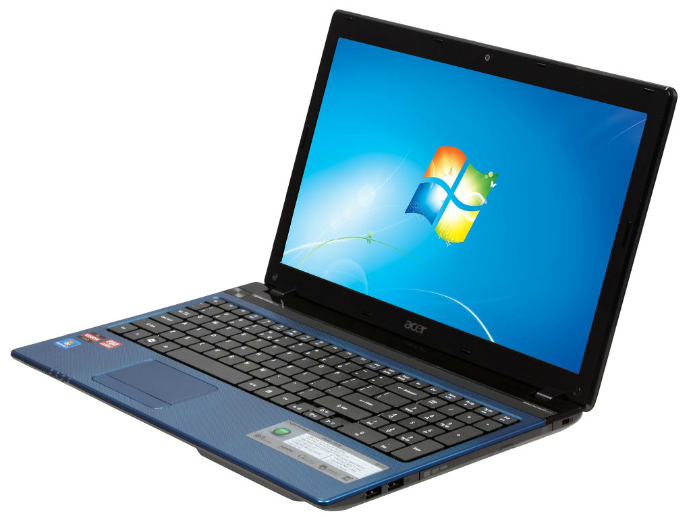
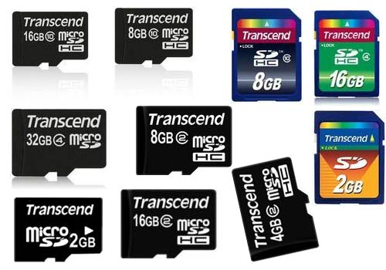
But in modern age, where are we staying?
To think, we become very excited because of-
We can carry the entire world of knowledge in a form in our laptops, mobiles and memory cards.
digital
Notes:
Digital may be used as a button here to show the meaning of the word.

Slide 30
B Read the text silently and answer the following questions.
How did people transfer ideas before writing was invented?
2. Why did people look for easy writing materials?
3. Why was knowledge very restricted in pre-paper age?
4. How has paper changed our life?
5. Where and when was paper invented?
Notes:
Reading and writing skill will be covered from this option.

Slide 31
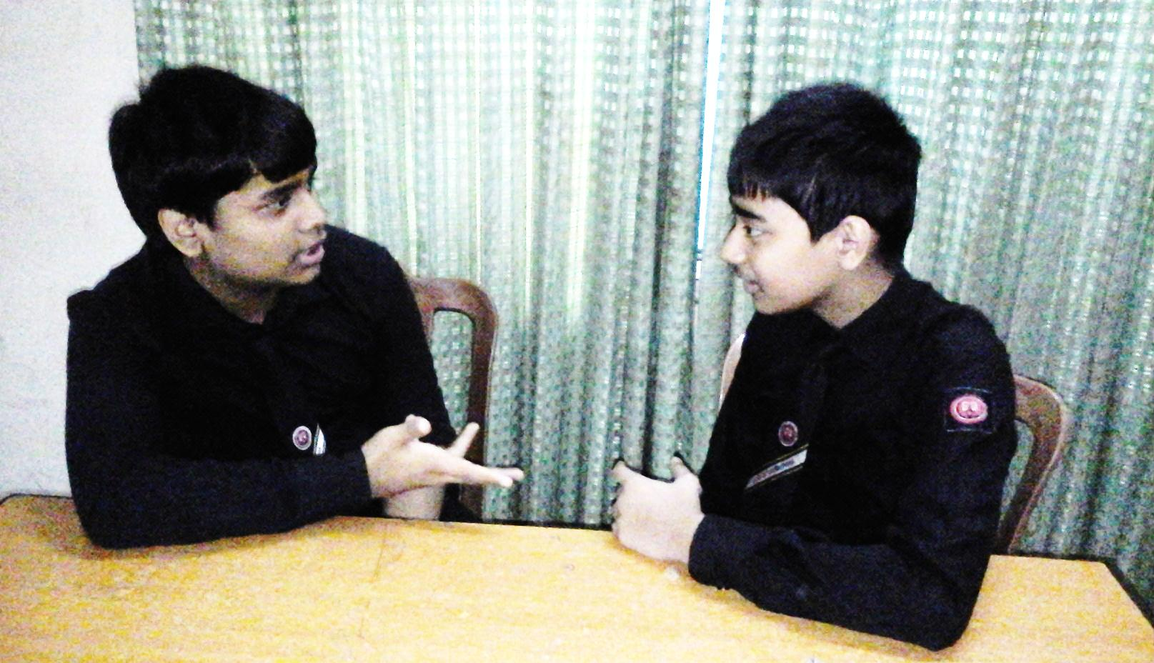
C Discuss with your partner and make a list of things other than paper on which we can write with pens, pencils, markers, brushes, paint/pastels etc.
Notes:
How to discuss in pairs.

Slide 32
D Listen to the teacher/CD carefully and complete the following sentences.
1 The person who invented paper is a ________ man.
2 He took the bark of a mulberry tree and _________ fibers.
3 This knowledge of _____________ was first used in China.
4 The word ‘paper’ is not ______________.
5 The word ‘paper’ was derived from a kind of Egyptian plant called ________
Chinese
bamboo
papermaking
a Bengali word
‘Papyrus’
Notes:
First teacher may place the sentences to fill in the gaps. Then he can show the answers to check if they are correct or not.

Slide 33
E Look at the following boxes first. Listen to the teacher/CD again. Then write in the boxes the series of works Ts’ai Lun’ did in making paper. First one and the last one are done for you.
1. He took the bark of Mulberry tree and bamboo fiber.
2. He mixed them_________
together.
3. He pounded _____________________
the mixer like powder.
4. He poured the mixer _________
into water.
5. He let the water _________________
mix with the thing.
6. He let the thing dry.
Notes:
Same as above.

Slide 34
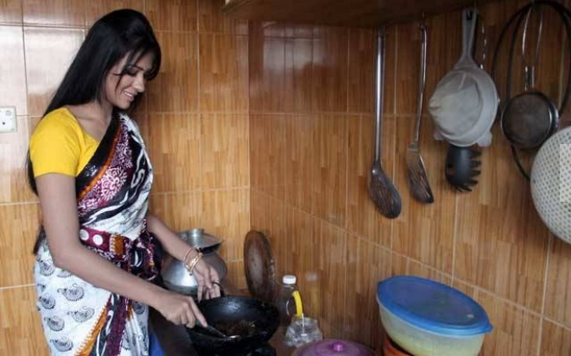
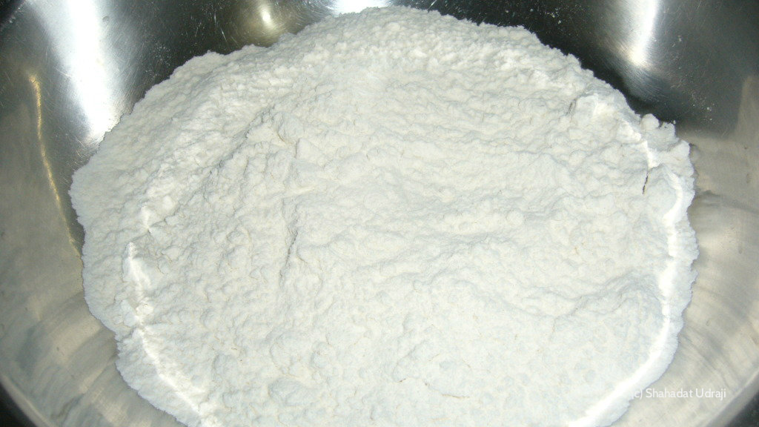
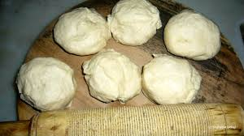
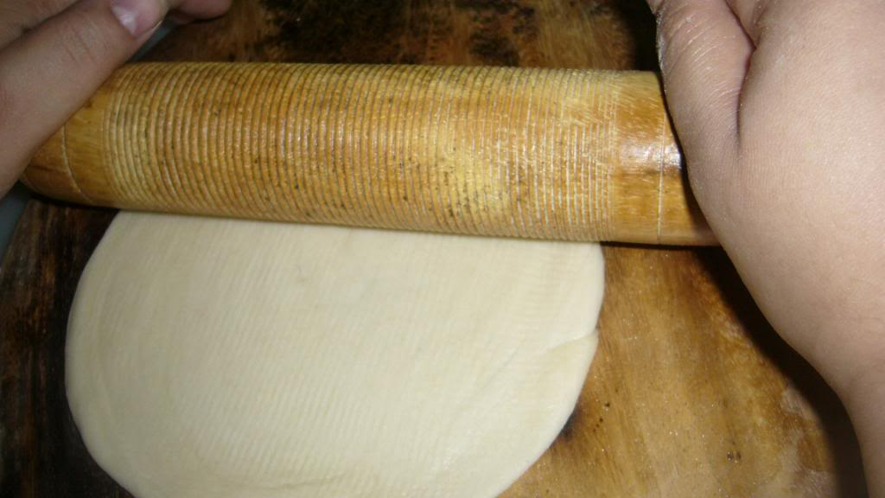
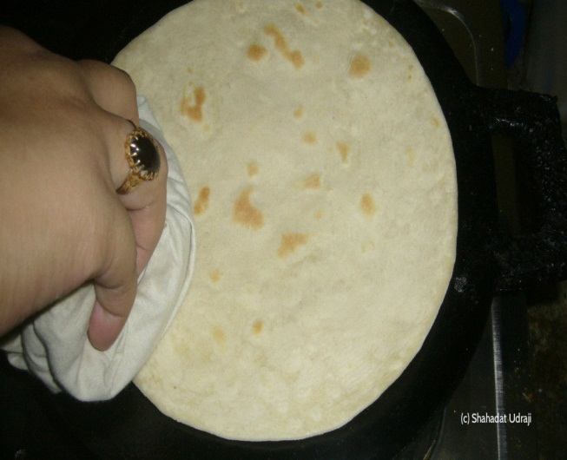
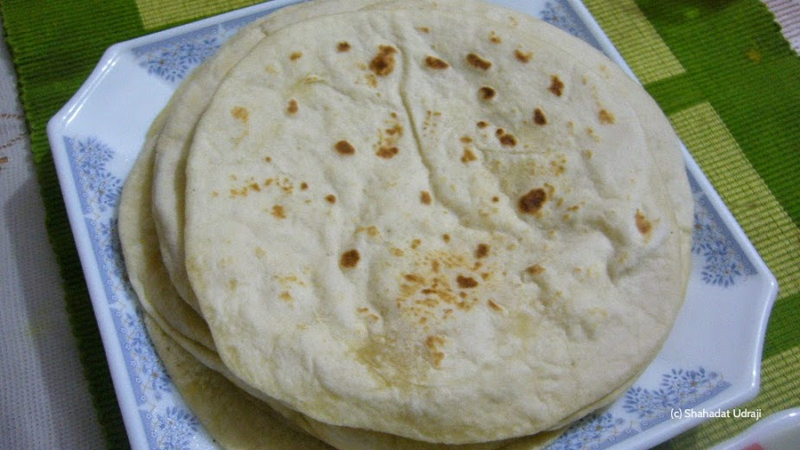
F PROJECT WORK: On weekend, observe how ruti or paratah is made in the kitchen. Carefully take notes of each step taken to make it. Then back in class, share your notes with your partner/group. Finally write how ruti or paratah is made and make a presentation in the class.
Notes:
The pictures may be the hints to advance this option.

Slide 35
Allah Hafiz

Slide 36
Acknowledgement
We would like to express our cordial gratitude to the Ministry of Education, Directorate of Secondary & Higher Education, NCTB, A2i and the panel of honorable editors ( Md. Jahangir Hasan, Assistant Professor (English) TTC, Rangpur, Ranjit Poddar, Associate Professor (English) TTC, Dhaka, and Urmila Khaled, Assistant Professor (English) TTC, Dhaka, to enrich the contents.

